Slide 1
7
The Skeleton:
Part B

Slide 2
Vertebral Column
Transmits weight of trunk to lower limbs
Surrounds and protects spinal cord
Flexible curved structure containing 26 irregular bones (vertebrae) in five major regions
  Cervical vertebrae (7)—vertebrae of neck
  Thoracic vertebrae (12)—vertebrae of thoracic cage
  Lumbar vertebrae (5)—vertebrae of lower back
  Sacrum—bone inferior to lumbar vertebrae
  Coccyx—terminus of vertebral column
© 2013 Pearson Education, Inc.

Slide 3
Vertebral Column: Curvatures
Increase resilience and flexibility of spine
  Cervical and lumbar curvatures
    Concave posteriorly
  Thoracic and sacral curvatures
    Convex posteriorly
Abnormal spine curvatures
  Scoliosis - abnormal lateral curve
  Kyphosis (hunchback) – exaggerated thoracic curvature
  Lordosis (swayback) – accentuated lumbar curvature
© 2013 Pearson Education, Inc.

Slide 4
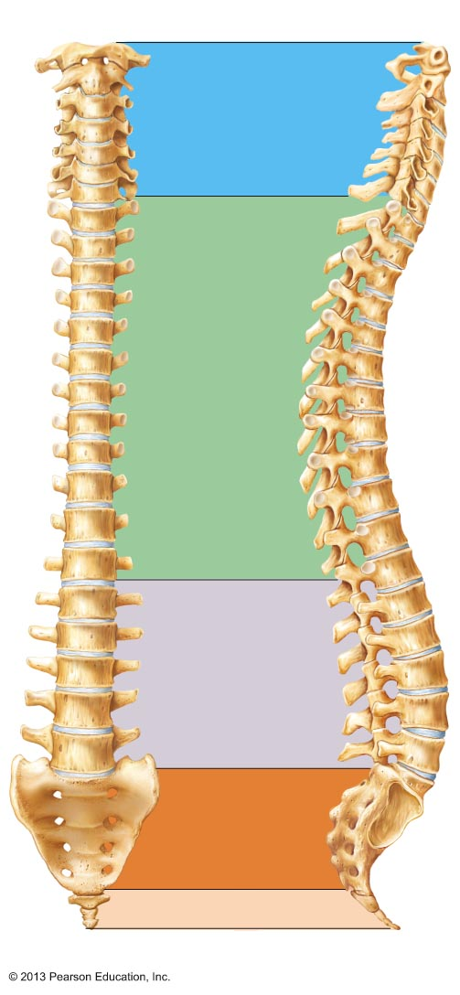
Figure 7.16 The vertebral column.
C₁
2
3
Cervical curvature (concave)
7 vertebrae, C₁ – C₇
4
5
6
7
T₁
Spinous
process
2
3
Transverse
processes
4
5
6
Thoracic curvature
(convex)
12 vertebrae,
T₁ – T₁₂
7
8
9
Intervertebral
discs
10
11
Intervertebral
foramen
12
L₁
2
Lumbar curvature
(concave)
5 vertebrae, L₁ – L₅
3
4
5
Sacral curvature
(convex)
5 fused vertebrae
sacrum
Coccyx
4 fused vertebrae
Anterior view
Right lateral view
© 2013 Pearson Education, Inc.

Slide 5
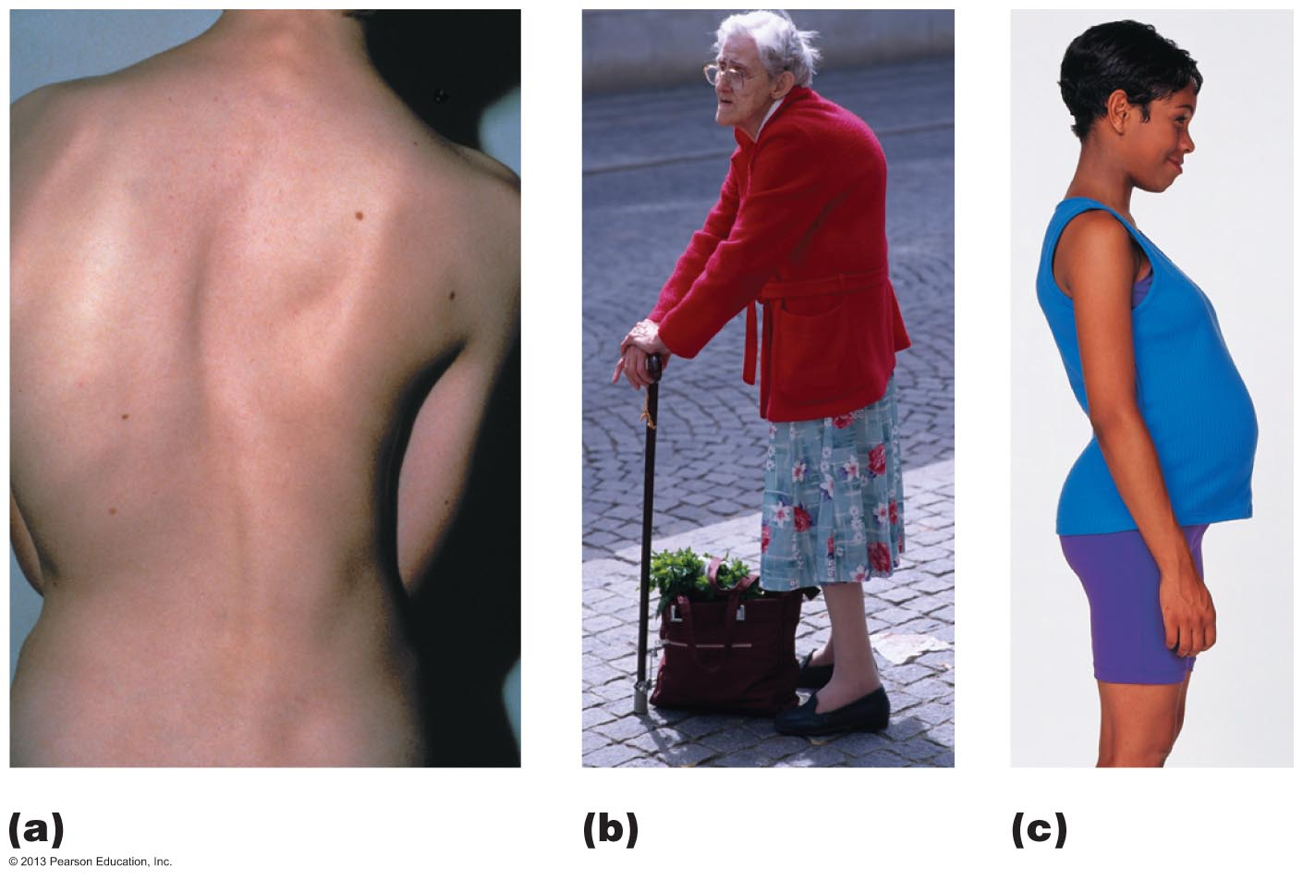
Figure 7.17 Abnormal spinal curvatures.
Scoliosis
Kyphosis
Lordosis
© 2013 Pearson Education, Inc.

Slide 6
Ligaments韧带
Anterior and posterior longitudinal ligaments
  From neck to sacrum
Ligamentum flavum
  Connects adjacent 毗连的 vertebrae
Short ligaments
  Connect each vertebra to those above and below
© 2013 Pearson Education, Inc.

Slide 7
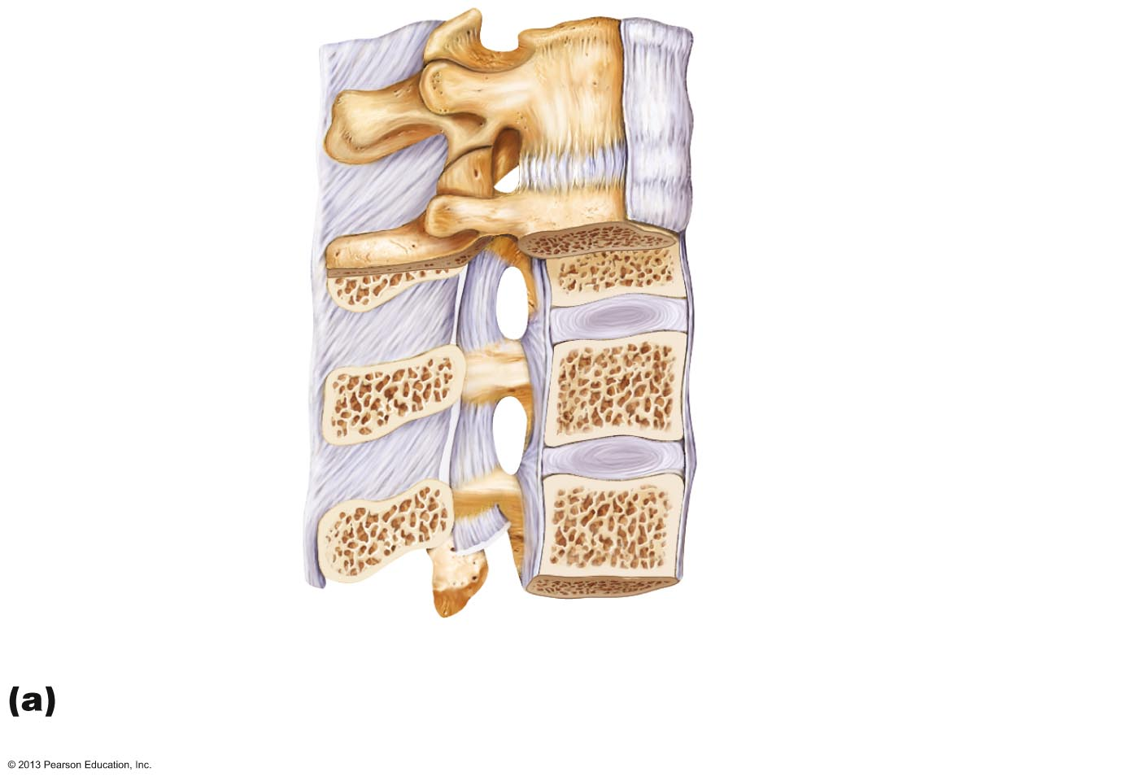
Figure 7.18a Ligaments and fibrocartilage discs uniting the vertebrae.
Supraspinous
ligament
Intervertebral
disc
Transverse
process
Anterior
longitudinal
ligament
Sectioned
spinous process
Intervertebral foramen
Ligamentum
flavum
Posterior longitudinal
ligament
Interspinous
ligament
Anulus fibrosus
Nucleus pulposus
Inferior articular
process
Sectioned body
of vertebra
Median section of three vertebrae, illustrating
the composition of the discs and the ligaments
© 2013 Pearson Education, Inc.

Slide 8
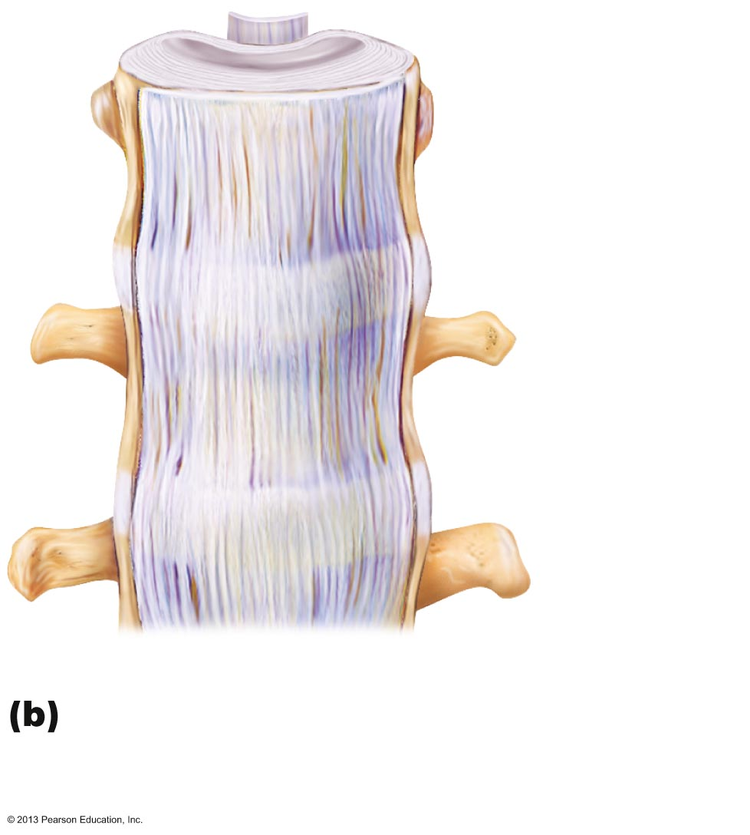
Figure 7.18b Ligaments and fibrocartilage discs uniting the vertebrae.
Posterior
longitudinal
ligament
Anterior
longitudinal
ligament
Body of a
vertebra
Intervertebral
disc
Anterior view of part of the spinal
column, showing the anterior
longitudinal ligament
© 2013 Pearson Education, Inc.

Slide 9
Intervertebral Discs椎间盘
Cushionlike pad composed of two parts
  Nucleus pulposus
    Inner gelatinous nucleus
    Gives disc its elasticity and compressibility
  Anulus fibrosus
    Outer collar composed of collagen and fibrocartilage
© 2013 Pearson Education, Inc.

Slide 10
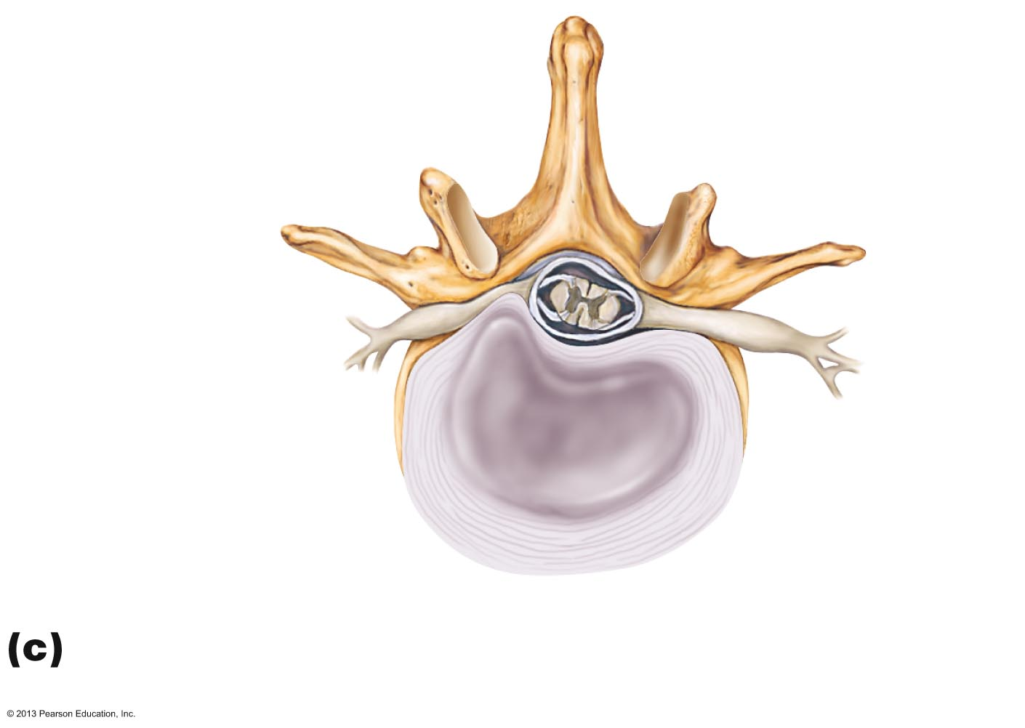
Figure 7.18c Ligaments and fibrocartilage discs uniting the vertebrae.
Vertebral spinous
process (posterior
aspect of vertebra)
Spinal cord
Spinal nerve
root
Transverse
process
Herniated
portion of disc
Anulus
fibrosus of disc
Nucleus
pulposus
of disc
Superior view of a herniated
intervertebral disc
© 2013 Pearson Education, Inc.

Slide 11
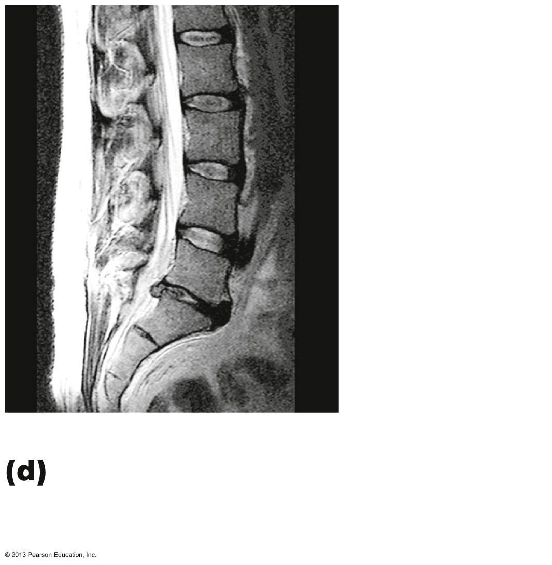
Figure 7.18d Ligaments and fibrocartilage discs uniting the vertebrae.
Nucleus
pulposus of
intact disc
Herniated
nucleus
pulposus
MRI of lumbar region of
vertebral column in sagittal
section showing herniated disc
© 2013 Pearson Education, Inc.

Slide 12
General Structure of Vertebrae
Body or centrum
  Anterior weight-bearing region
Vertebral arch
  Composed of pedicles and laminae that, along with centrum, enclose vertebral foramen
Vertebral foramina
  Together make up vertebral canal for spinal cord
Intervertebral foramina
  Lateral openings between adjacent vertebrae for spinal nerves
© 2013 Pearson Education, Inc.

Slide 13
General Structure of Vertebrae
Seven processes per vertebra:
  Spinous process—projects posteriorly
  Transverse processes (2)—project laterally
  Superior articular processes (2)—protrude superiorly
  Inferior articular processes (2)—protrude inferiorly
PLAY
Animation: Rotatable Spine (Horizontal)
PLAY
Animation: Rotatable Spine (Vertical)
© 2013 Pearson Education, Inc.

Slide 14
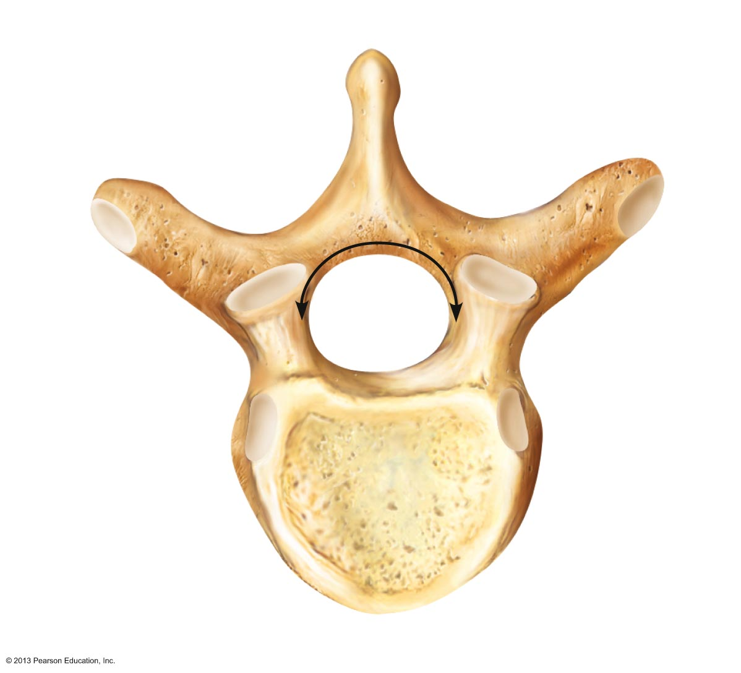
Figure 7.19 Typical vertebral structures.
Posterior
Spinous
process
Transverse
process
Superior
articular
Vertebral
arch
facet
and
• Lamina
process
• Pedicle
Vertebral
foramen
Body
(centrum)
Anterior
© 2013 Pearson Education, Inc.

Slide 15
Cervical Vertebrae
C₁ to C₇: smallest, lightest vertebrae
C₃ to C₇ share following features
  Oval body
  Spinous processes are bifid (except C₇)
  Large, triangular vertebral foramen
  Transverse foramen in each transverse process
  C₇ is vertebra prominens
© 2013 Pearson Education, Inc.

Slide 16
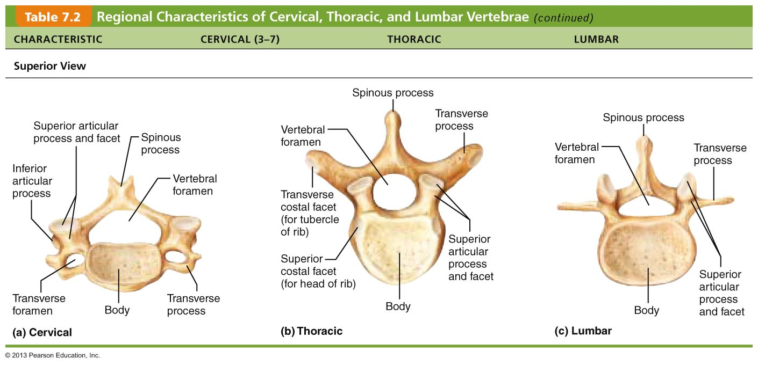
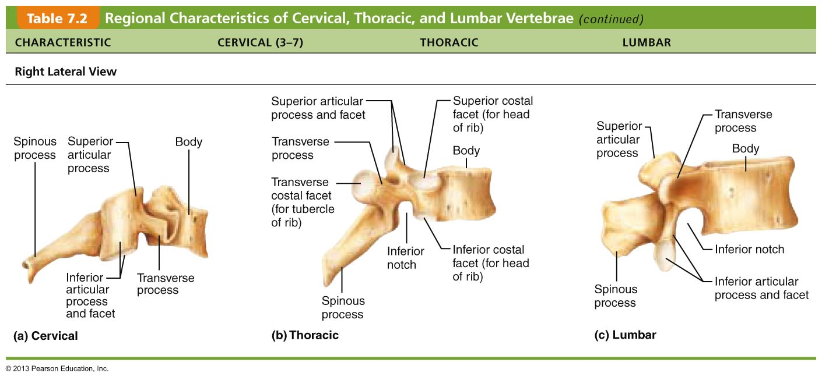
Table 7.2 Regional Characteristics of Cervical
© 2013 Pearson Education, Inc.

Slide 17
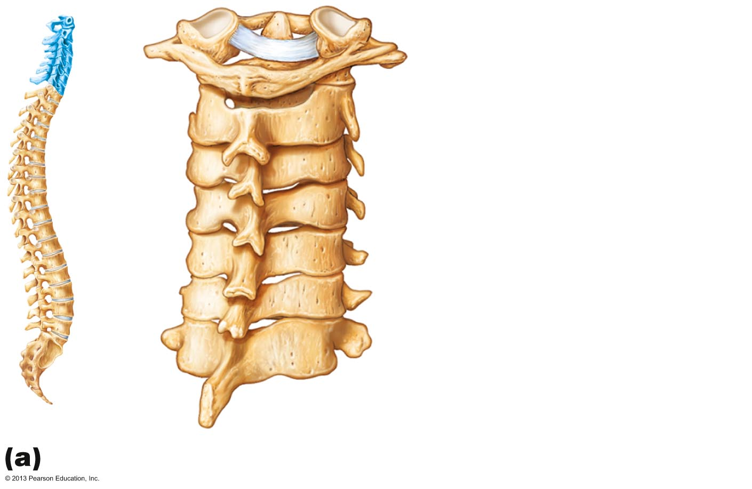
Figure 7.21a Posterolateral views of articulated vertebrae.
Dens of axis
Transverse ligament
of atlas
C₁ (atlas)
C₂ (axis)
C₃
Inferior articular process
Bifid spinous process
Transverse processes
C₇ (vertebra
prominens)
Cervical vertebrae
© 2013 Pearson Education, Inc.

Slide 18
Cervical Vertebrae
C₁ (atlas) and C₂ (axis) have unique features
Atlas (C₁)
  No body or spinous process
  Consists of anterior and posterior arches, and two lateral masses
  Superior surfaces of lateral masses articulate with occipital condyles
  Movement for "Yes"
© 2013 Pearson Education, Inc.

Slide 19
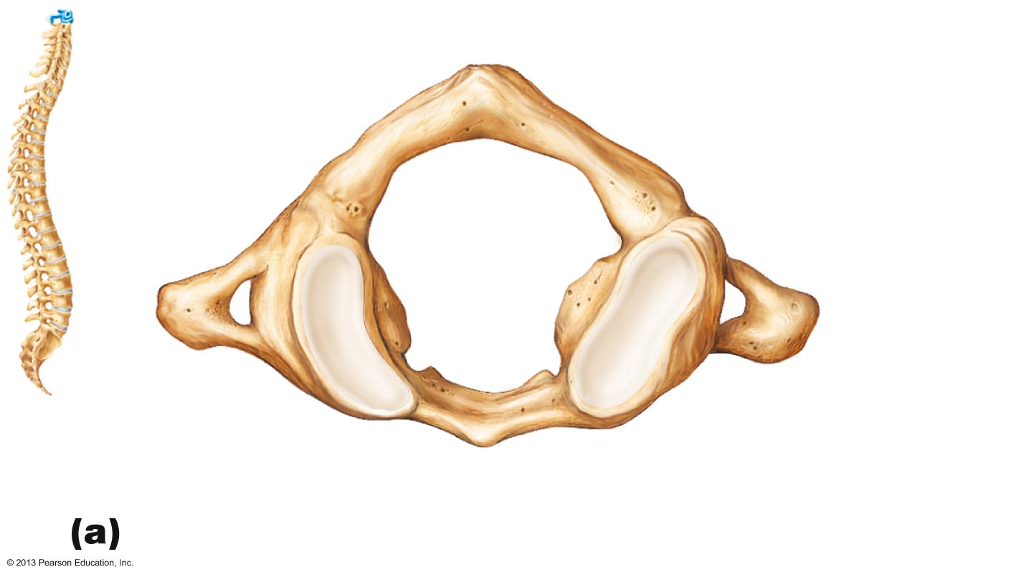
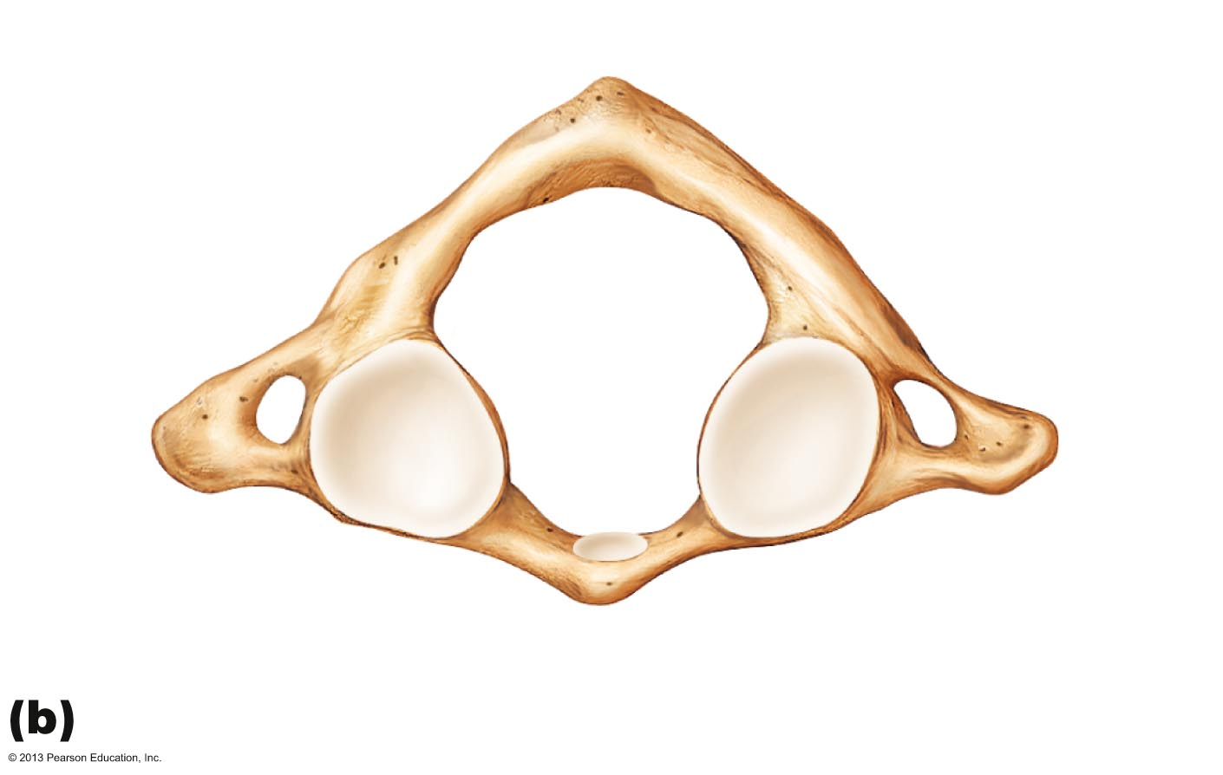
Figure 7.20a–b The first and second cervical vertebrae.
C₁
Posterior
Posterior
Posterior
tubercle
Posterior
arch
Posterior tubercle
Posterior
arch
Inferior
articular
facet
Transverse
process
Transverse
foramen
Lateral
masses
Lateral
masses
Superior
articular
facet
Transverse
foramen
Anterior arch
Anterior arch
Anterior tubercle
Facet for dens
Anterior tubercle
Superior view of atlas (C₁)
Inferior view of atlas (C₁)
© 2013 Pearson Education, Inc.

Slide 20
Cervical Vertebrae
Axis (C₂)
  Dens projects superiorly into anterior arch of atlas
    Is "missing" body of atlas
  Dens is a pivot for rotation of atlas
  Movement for "No"
© 2013 Pearson Education, Inc.

Slide 21
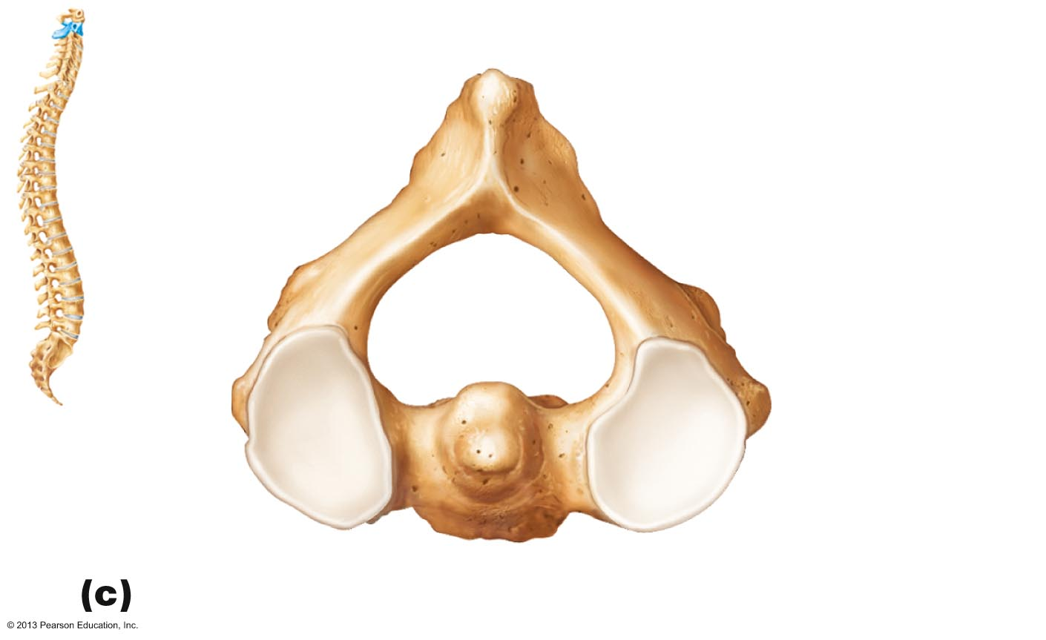
Figure 7.20c The first and second cervical vertebrae.
Posterior
C₂
Spinous process
Inferior
articular
process
Lamina
Pedicle
Superior
articular
facet
Transverse
process
Dens
Body
Superior view of axis (C₂)
© 2013 Pearson Education, Inc.

Slide 22
Thoracic Vertebrae
T₁ to T₁₂
All articulate with ribs at facets and demifacets
Long, spinous process that points inferiorly
Circular vertebral foramen
Location of articular facets allows rotation of this area of spine
© 2013 Pearson Education, Inc.

Slide 23
Table 7.2 Regional Characteristics of Thoracic
© 2013 Pearson Education, Inc.

Slide 24
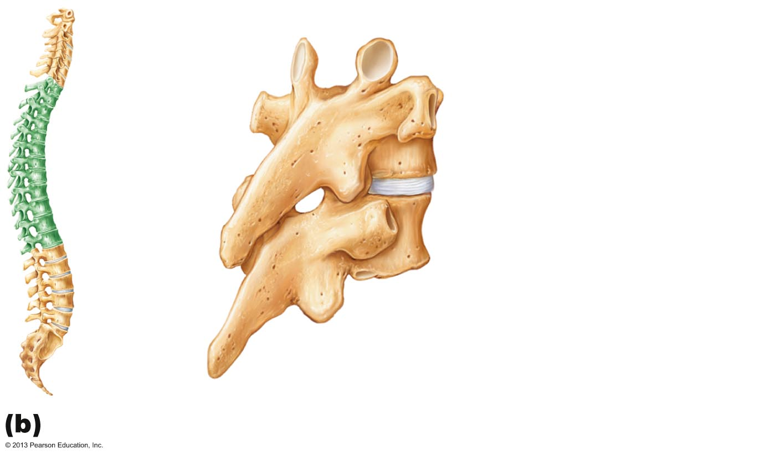
Figure 7.21b Posterolateral views of articulated vertebrae.
Superior articular
process
Transverse
process
Transverse costal
facet (for tubercle of rib)
Intervertebral disc
Body
Inferior costal facet
(for head of rib)
Spinous
process
Inferior articular
process
Thoracic vertebrae
© 2013 Pearson Education, Inc.

Slide 25
Lumbar Vertebrae
L₁ to L₅
Receives most stress
Short, thick pedicles and laminae
Flat hatchet-shaped spinous processes point posteriorly
Vertebral foramen triangular
Orientation of articular facets locks lumbar vertebrae together to prevent rotation
© 2013 Pearson Education, Inc.

Slide 26
Table 7.2 Regional Characteristics of Vertebrae
© 2013 Pearson Education, Inc.

Slide 27
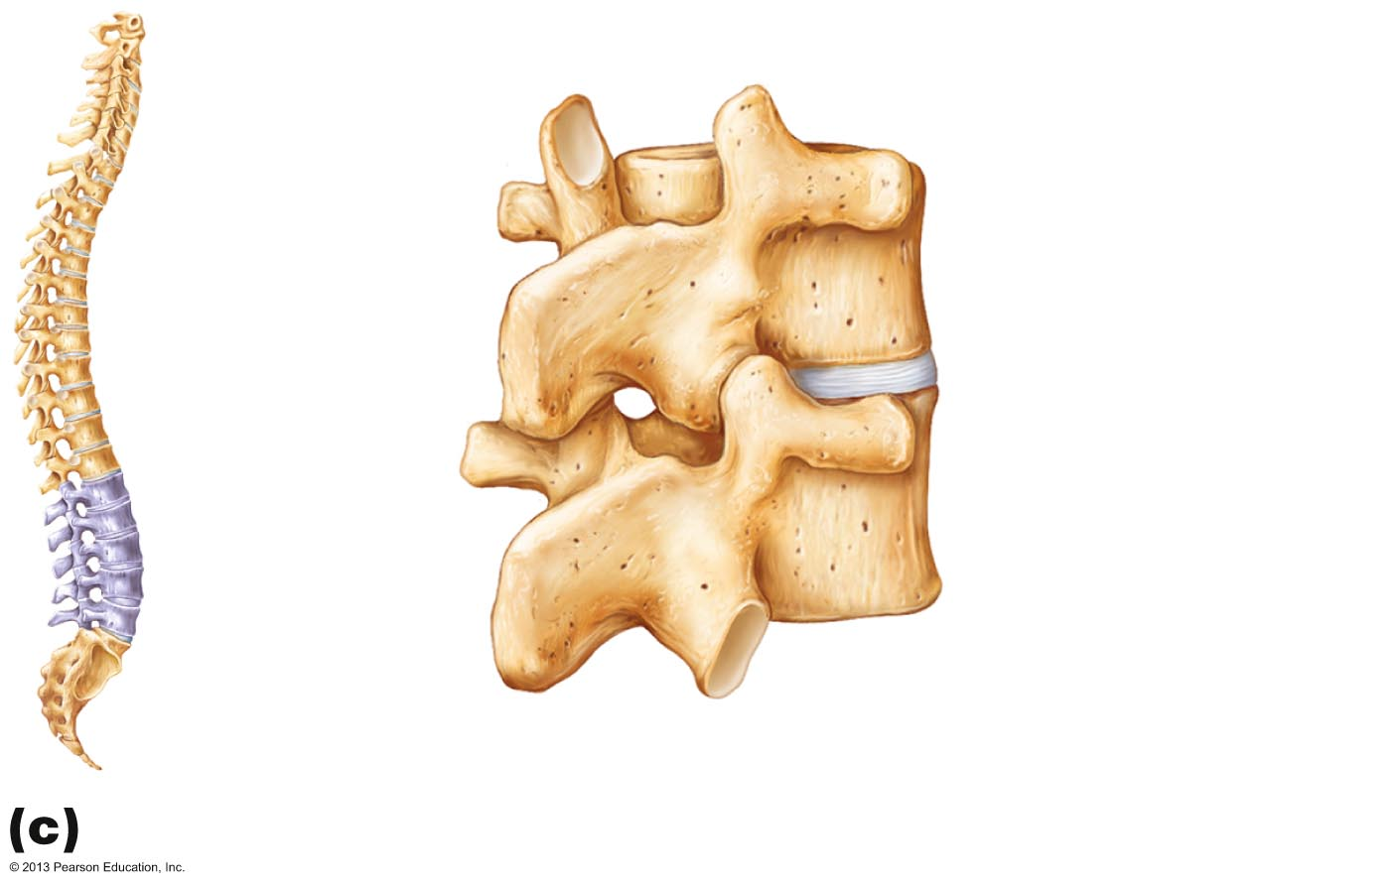
Figure 7.21c Posterolateral views of articulated vertebrae.
Superior
articular
process
Body
Transverse
process
Intervertebral
disc
Inferior articular
process
Spinous
process
Lumbar vertebrae
© 2013 Pearson Education, Inc.

Slide 28
Sacrum and Coccyx
Sacrum
  5 fused vertebrae (S1–S5)
  Forms posterior wall of pelvis
  Articulates with L5 superiorly, and with auricular surfaces of hip bones, forming sacroiliac joints
Coccyx
  Tailbone
  3–5 fused vertebrae
  Articulates superiorly with sacrum
© 2013 Pearson Education, Inc.

Slide 29
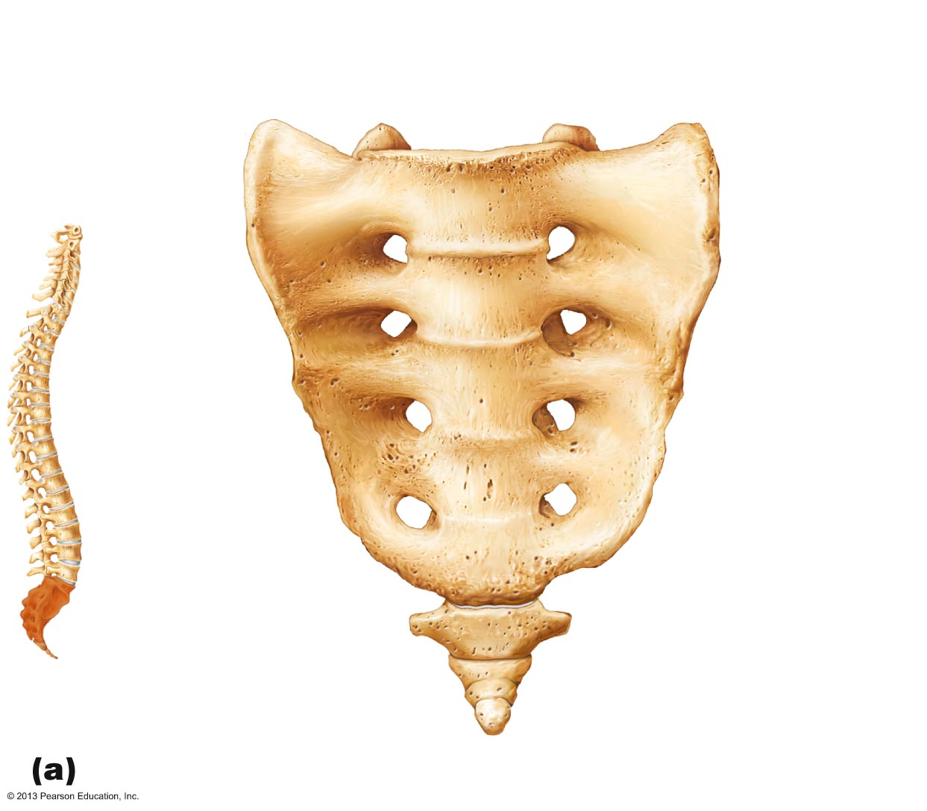
Figure 7.22a The sacrum and coccyx.
Sacral promontory
Ala
Body of
first sacral
vertebra
Transverse
ridges (sites of
vertebral fusion)
Anterior
sacral
foramina
Apex
Coccyx
Anterior view
© 2013 Pearson Education, Inc.

Slide 30
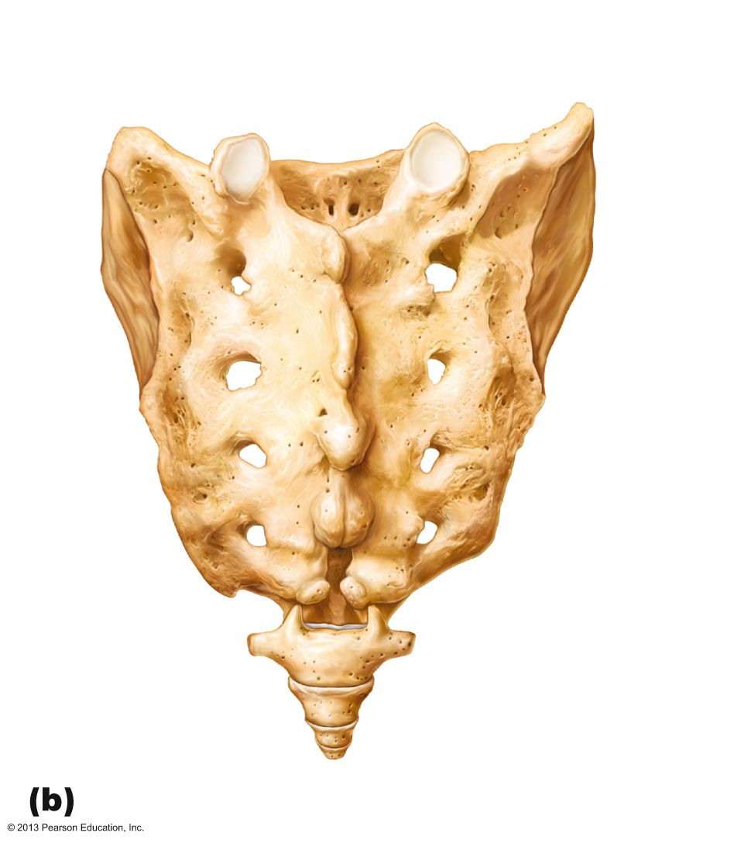
Figure 7.22b The sacrum and coccyx.
Facet of
superior
articular
process
Body
Sacral
canal
Ala
Auricular
surface
Median
sacral
crest
Lateral
sacral
crest
Posterior
sacral
foramina
Sacral
hiatus
Coccyx
Posterior view
© 2013 Pearson Education, Inc.

Slide 31
Thoracic Cage
Composed of
  Thoracic vertebrae posteriorly 后来地
  Sternum and costal cartilages anteriorly
  Ribs laterally
Functions
  Protects vital organs of thoracic cavity
  Supports shoulder girdles and upper limbs
  Provides attachment sites for muscles of neck, back, chest, and shoulders
© 2013 Pearson Education, Inc.

Slide 32
Sternum (Breastbone)
Three fused 熔化的 bones
  Manubrium – Superior portion
    Articulates with clavicles and ribs 1 and 2
  Body (midportion)
    Articulates with costal cartilages of ribs 2 through 7
  Xiphoid process – Inferior end
    Site of muscle attachment
    Not ossified until ~age 40
© 2013 Pearson Education, Inc.

Slide 33
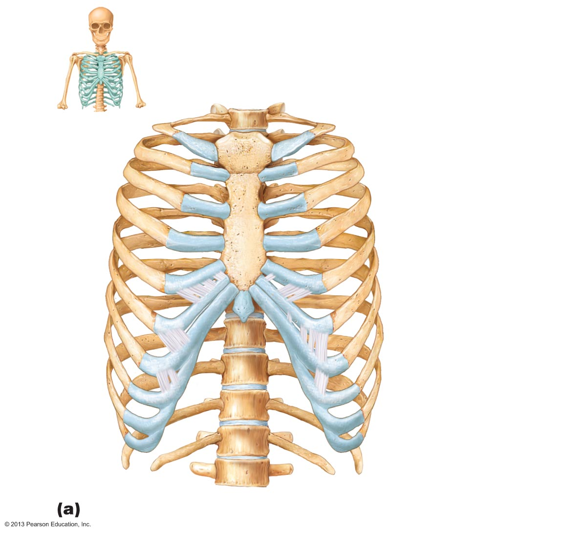
Figure 7.23a The thoracic cage.
Jugular notch
Clavicular notch
Manubrium
Sternal angle
Body
Xiphisternal
joint
Sternum
True ribs
(1–7)
Xiphoid
process
False ribs
(8–12)
Intercostal
spaces
Floating ribs
(11, 12)
L₁
Vertebra
Costal cartilage
Costal margin
Skeleton of the thoracic cage, anterior view
© 2013 Pearson Education, Inc.

Slide 34
Anatomical Landmarks Of Sternum
Jugular notch
  Central indentation in superior border of manubrium
Sternal angle
  Horizontal ridge across front of sternum
Xiphisternal joint
  Point where sternal body and xiphoid process fuse
© 2013 Pearson Education, Inc.

Slide 35
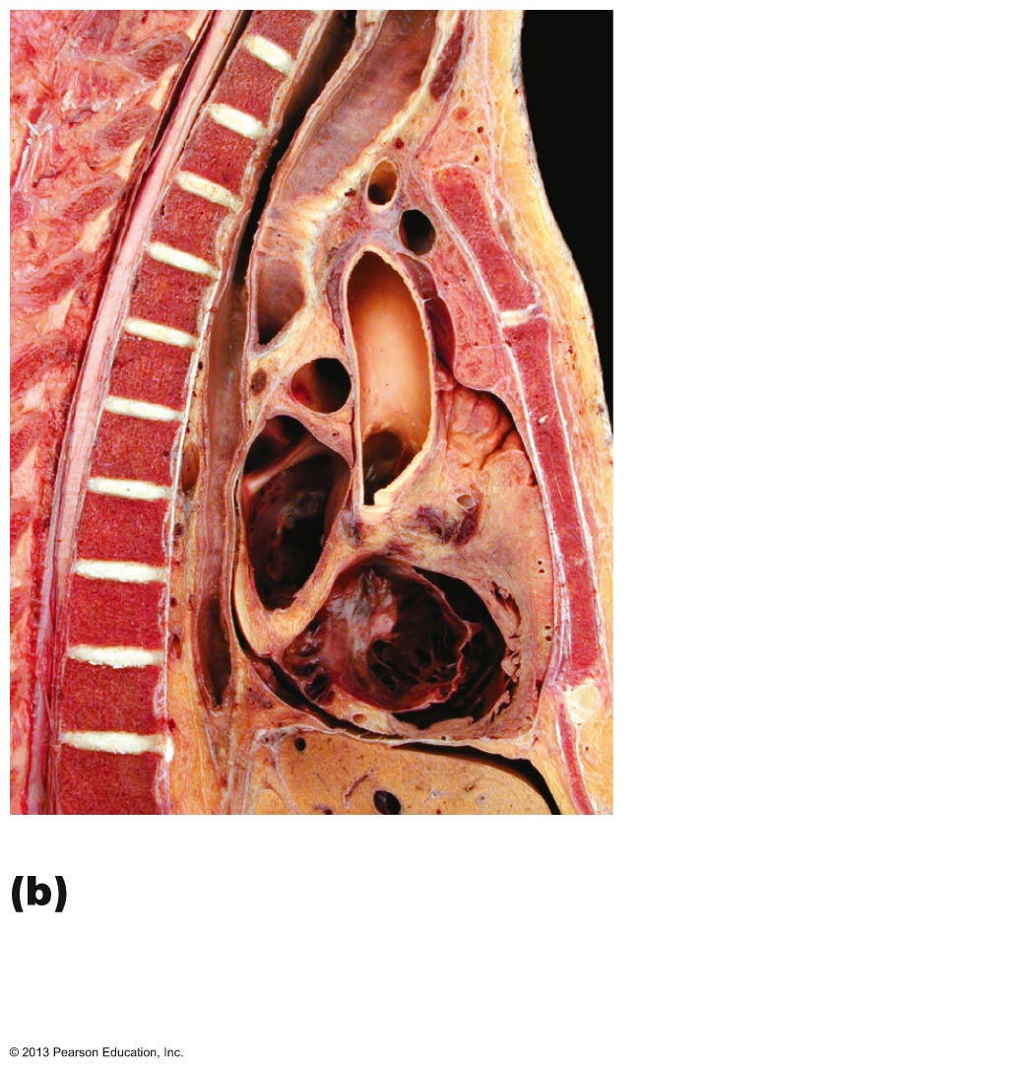
Figure 7.23b The thoracic cage.
T₂
Jugular notch
T₃
T₄
Sternal angle
Heart
T₉
Xiphisternal
joint
Midsagittal section through the thorax,
showing the relationship of surface
anatomical landmarks of the thorax to the
vertebral column
© 2013 Pearson Education, Inc.

Slide 36
Ribs and Their Attachments
12 pairs
All attach posteriorly to bodies and transverse processes of thoracic vertebrae
Pairs 1 through 7
  True (vertebrosternal) ribs
  Attach directly to sternum by individual costal cartilages
© 2013 Pearson Education, Inc.

Slide 37
Ribs and Their Attachments
Pairs 8 through12
  False ribs
  Pairs 8–10 also called vertebrochondral ribs
    Attach indirectly to sternum by joining costal cartilage of rib above
  Pairs 11–12 also called vertebral (floating) ribs
    No attachment to sternum
© 2013 Pearson Education, Inc.

Slide 38
Figure 7.23a The thoracic cage.
Jugular notch
Clavicular notch
Manubrium
Sternal angle
Body
Xiphisternal
joint
Sternum
True ribs
(1–7)
Xiphoid
process
False ribs
(8–12)
Intercostal
spaces
Floating ribs
(11, 12)
L₁
Vertebra
Costal cartilage
Costal margin
Skeleton of the thoracic cage, anterior view
© 2013 Pearson Education, Inc.

Slide 39
Rib Structure
Main parts:
  Head (posterior end)
    Articulates with facets (demifacets) on bodies of two adjacent vertebrae
  Neck (constricted portion beyond head)
  Tubercle (lateral to neck)
    Articulates posteriorly with transverse costal facet of same-numbered thoracic vertebra
  Shaft
    Most of rib
© 2013 Pearson Education, Inc.

Slide 40
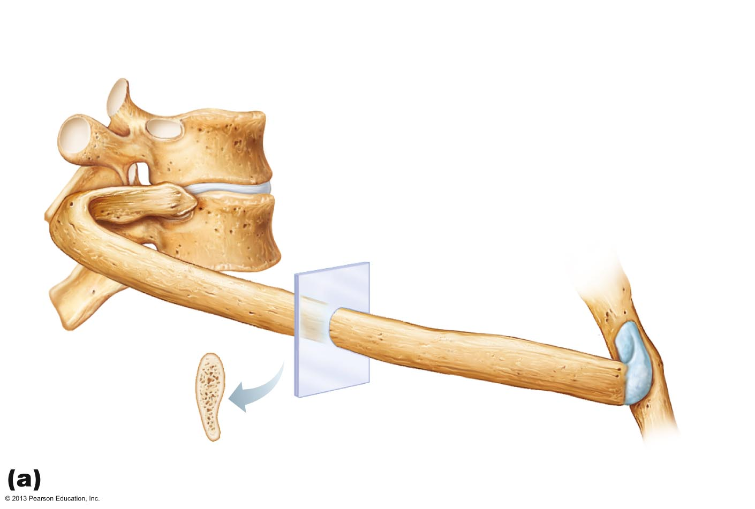
Figure 7.24a Ribs.
Transverse costal facet
(for tubercle of rib)
Superior costal facet
(for head of rib)
Angle
of rib
Body of vertebra
Head of rib
Intervertebral disc
Neck of rib
Tubercle of rib
Shaft
Sternum
Cross-
section
of rib
Costal groove
Costal cartilage
Vertebral and sternal articulations of a typical true rib
© 2013 Pearson Education, Inc.

Slide 41
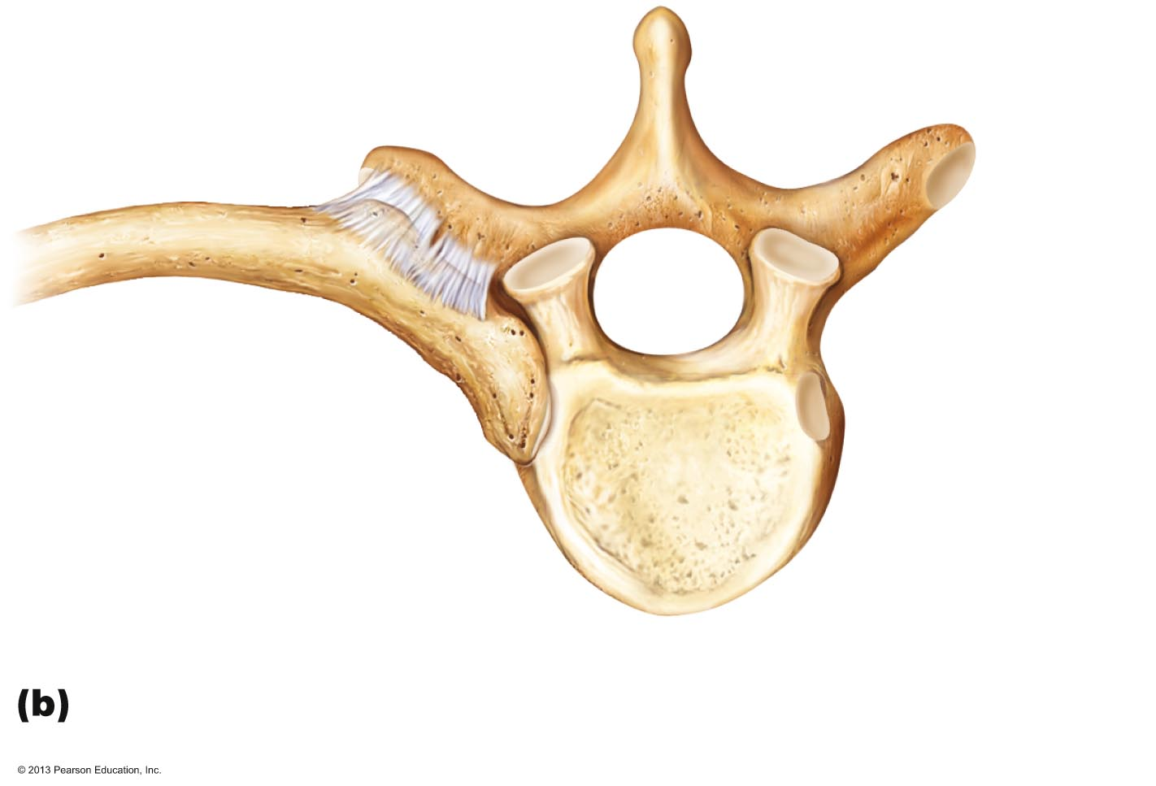
Figure 7.24b Ribs.
Articular facet
on tubercle of rib
Spinous process
Shaft
Transverse
costal facet
(for tubercle
of rib)
Ligaments
Neck of rib
Head of rib
Body of
thoracic
vertebra
Superior costal facet
(for head of rib)
Superior view of the articulation between a rib and a
thoracic vertebra
© 2013 Pearson Education, Inc.

Slide 42
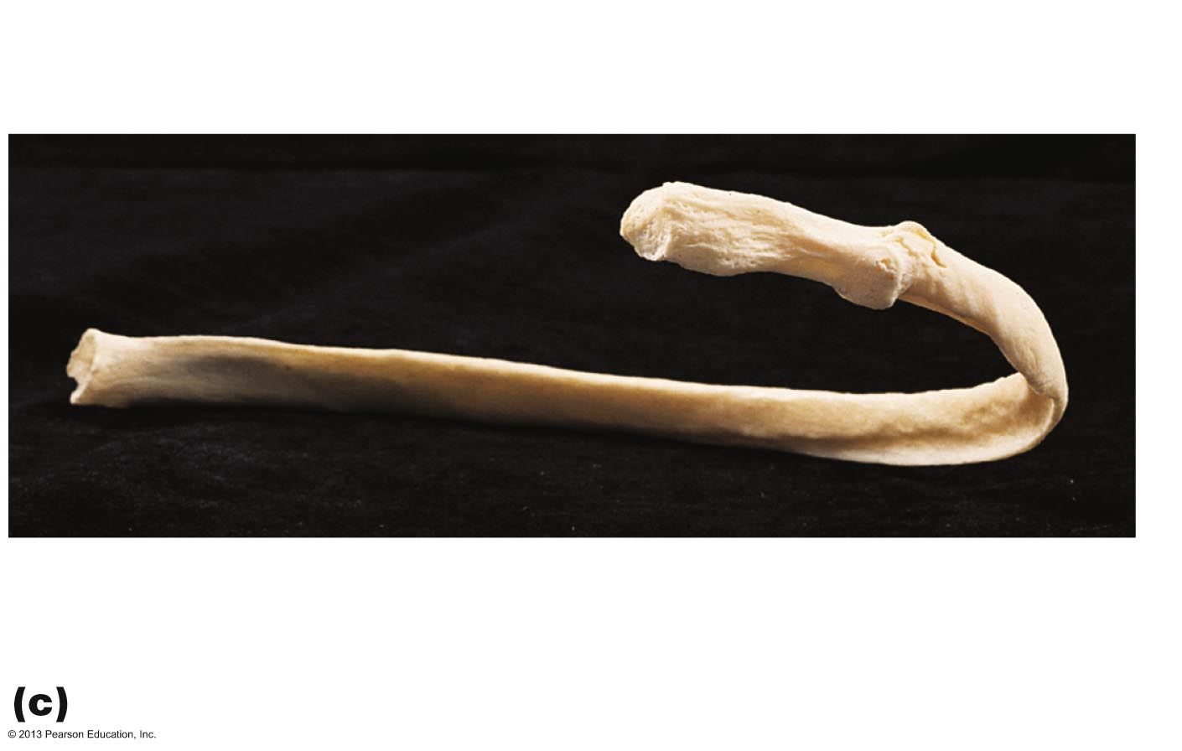
Figure 7.24c Ribs.
Facets for articulation
with vertebrae
Articular facet
on tubercle
Shaft
Head
Neck
Junction with
costal cartilage
Costal groove
Angle of rib
A typical rib (rib 6, right), posterior view
© 2013 Pearson Education, Inc.

